Slide 1



S U R V I V O R
T O O L K I T
SUPPORTLINE: 1 - 855 - BTS- 1777
BTSADV. ORG

Slide 2


BTSADV Survivor Toolkit
Table of Contents
Finance Basics
1 - 2
Staying Safe After You Leave An Abuser
3
Healthy & Unhealthy Relationships
4
Understanding the Stages of Grief
5
Gaining Independence & Finding Yourself
6
Creating and Identifying Support Systems
7 - 8
SUPPORTLINE: 855 - BTS- 1777
BTSADV. ORG

Slide 3

BTSADV Survivor Toolkit
Finance Basics
Fundamentals and tools to help establish financial freedom after leaving an abuser
Advice
Keep a written budget so you can tell your money where to go, and see where it is going. Use cash for in purchase transactions; it makes it more personal so you will spend less.
Wait at least 24 hours before making big, or impulse purchases.
Priorities: Food, shelter, clothing, transportation Within reason. Remember you do not NEED a steak and lobster dinner every night,
$500,000 house, $100 jeans or a $40,000 car to survive.
You can work deals with creditors - get it in writing! Never allow electronic access, and no post dated checks.
You can call and work out different payment arrangements or even offer to pay 30-50% up front or pay in full to cancel out the debt completely. Their first offer is never the best offer.
Balance Your Checking Account
Keep your account register (or excel sheet) current by subtracting checks, debit card purchase, automatic bill payments, other withdrawals (service charges, ATM fees...) and by adding deposits as they are made to keep your account balanced correctly. Verify purchase/fees frequently.
Verify your checking account within 72 hours of receiving your bank statement to make sure there aren’t any mistakes.
SUPPORTLINE: 855 - BTS- 1777
BTSADV. ORG

Slide 4

BTSADV Survivor Toolkit
Finance Basics (Continued)
Basic Budget
(See Spreadsheet at btsadv.org/finance)
This is not a one size fits all budget, it is a place to start. Add in extras as needed. Recommended: Keep a spreadsheet so it does the math for you.
Flag any item you are behind in payments, and be sure to catch up and/or work out a deal with the biller.
If you do not know exact totals on what you spend, guess. Then track everything for a month. Within a few months you will know how to budget more accurately. You may even be surprised how much you spend unnecessarily.
Create columns: bills & expenses/ due dates/ if you have paid the bill/ the amount of the bill/ and how much is left in your account.
Complete this for every paycheck in the month so you can allocate money to bills throughout the month.
Debt Snowball
(See Chart at btsadv.org/finance)
Make a list of your debts.
List them in order from lowest balance to the highest. List the minimum payments due.
Pay off the lowest debt first then use the money from that minimum payment and add it to the next on the list.
To help get moving quickly, pay more than the minimum of the first on the list or find a creative way to make extra money to pay it off.
Credit Bureaus
Experian:
(888) 397-3742
www.experian.com
Be Proactive!
To decrease unauthorized mail marketing (including pre-approved credit card offers) and unwanted telemarketing calls contact:
Equivalencies Credit Bureau: (800) 685-1111
www.equifax.com
Pre-screening opt-out:
(888) 567-8688 | www.optoutprescreen.com
Transunion Credit Bureau (800) 888-4213
www.transunion.com
National Do Not Call Registry
(888) 382-1222 | www.donotcall.gov
For detailed information on your rights and options regarding direct marketing visit the Direct Marketing Associations website: www.dmachoice.org
SUPPORTLINE: 855 - BTS- 1777
BTSADV. ORG

Slide 5
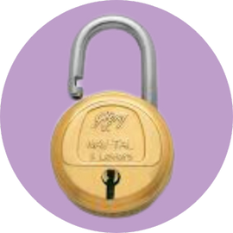

BTSADV Survivor Toolkit
Staying Safe:
After You Leave An Abuser
Recommendations for protecting yourself and your family while establishing independence
Utilize Restraining Orders
Keep a certified copy of your restraining order with you at all times.
Inform friends, neighbors, and employers that you have a restraining order in effect. Give copies of the restraining order to employers, neighbors, and schools, along with a picture of the offender.
Call law enforcement to enforce the order if necessary.
Adjust Your Routine
Change your work hours (if possible) and usual route to and from work.
Change the route taken to transport children to and from school.
Alert school authorities of the situation. Consider changing your children’s schools. Reschedule appointments that the offender is aware of.
Use different stores and frequent different social spots.
Protect Your Contact Info
Change your phone number and request your new number be unlisted. Be careful who you share the new number with, and screen unfamiliar numbers.
Protect your mail. If you don't want a PO Box, check your mail every day, and shred mail with identifying information (bank statements, pre-approved credit cards or appointments)
Send outgoing mail from the post office instead of your home.
Protect Your Home
Change your locks, even if they have returned the key.
Check all window locks and ensure they are locked. (Even on the second floor of your home) Install an alarm system and cameras if possible. Keep the outside of your house well lit.
Trim bushes, trees, and other shrubbery to eliminate blind spots.
Replace wooden doors with steel or metal doors.
Install a motion sensitive lighting system.
Establish Support Systems
Alert neighbors and request that they call the police if they feel you may be in danger. Talk to trusted people about the violence.
Tell people you work with about the situation and have your calls screened by one receptionist if possible.
Tell people who take care of your children who can pick them up. Explain your situation to them and provide them with a copy of the restraining order, if you have one.
SUPPORTINE: 855 - BTS- 1777
BTSADV. ORG

Slide 6




BTSADV Survivor Toolkit
Healthy & Unhealthy Relationships
Understanding the difference between appropriate and inappropriate treatment in a relationship
Healthy
Compromise
Built on mutual respect Partnership
Trusting
Can be yourself Feel safe
Support & encouragement Respectful of boundaries
Supports relationships with friends and family Honest, open and safe communication Allows you freedom and respects your time
Supports your time for your own interests & schedule
Unhealthy
Monitors everything you do. Monitors your whereabouts by excessive calls or texts, asks for pictures to prove where you are, tracks you using GPS, key-logging software, or other means. Monitors your calls, texts, emails, social media, voicemail, & opens your mail.
Dominating and controlling. Won’t have open conversations. Doesn’t care about your thoughts or feelings. Accuses you of lying. Blames you for everything. Won’t own up to their wrong doings. Bad gut feeling. Substance abuse.
Open expression of jealousy over time spent with family or friends; limits time and
communication. Abuser insists on accompanying you everywhere you go, including to places their presence is inappropriate or not allowed. Manipulation to force or trick a partner to agree to something. Constantly ask/need to know where you are & where you are going. Survivor feeling constantly on guard & concerned about partner’s behavior. Survivor always walking on eggshells.
Restricts or blocks access to family transportation, finances, and lines of credit. Confiscates
paychecks. Forced accounting of all spending regardless of insignificant amounts. Unrealistic allowance for necessities. Forces you to be the sole breadwinner or does not allow you to work. Not interested in your success & may actually cut you down instead of celebrating you. Systemic lack of support or deliberate roadblocks to growth or pursuing goals. Pervasive sense of insecurity.
Physically hits you (pushing, slapping, punching, kicking, dragging by the hair, using weapons, or
any other means of assault). Throws objects near you. Uses threats of harm (against you, children, pets, or family) to coerce you into doing something. Leaves you stranded in unfamiliar places. Locks you out of the residence. Holds you against your will. Controls what you wear (clothes, makeup, jewelry, hair). Criticizes, insults, and intentionally demeans you to undermine your self-confidence. Puts you down in front of others. Uses gas-lighting to confuse & manipulate you. Finds ways to cut you down & make you feel insecure about yourself. Threatens to break up with you, giving you a sense that there is no relationship security. Ignores you & makes you feel alone when you are with them. Refusal to respect boundaries or needs in the relationship. Frequent breakups & makeups. Dishonesty & evasiveness. Inability or refusal to commit. Won’t allow time apart. Frequent accusations of cheating. Engages in sexual abuse, rape, or coerces you into things you are not comfortable with. Forced pregnancy.
SUPPORTLINE: 855 - BTS- 1777
BTSADV. ORG

Slide 7
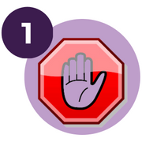


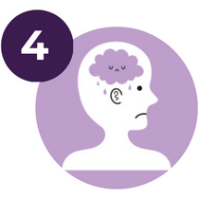
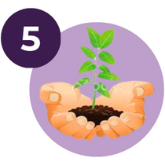
BTSADV Survivor Toolkit
Understanding the Stages of Grief1
Helping you acknowledge your past experience in a healthy way.1 2
Denial
Getting through the challenges that are connected to the past and giving yourself permission to experience this.
Anger
Get upset, healthy release, challenge your thoughts, deep breath in (take in the negative), and deep breath out (release its stronghold).
3
Bargaining
Understand what is best for your life, get curious, do real thinking.
Depression
Sadness, anxiety, difficult feelings, knowing it's okay to feel these things. Keep in mind that moving forward is necessary for overall well-being.
Acceptance
Recover and elevate past the pain, understand that it no longer owns you and you can grow from it.
SUPPORTLINE: 855 - BTS- 1777
BTSADV. ORG

Slide 8









BTSADV Survivor Toolkit
Gaining Independence & Finding Yourself
Helping you reclaim your freedom and find yourself again after trauma
Defining Values
Get in-tune with yourself and establish core values.
Finding Strength
Acknowledge your inner beauty and strength and embrace it.
Tools
for Finding Yourself
Patience
Be patient with yourself.
Discovering Passions
Re-discover old passions and try new hobbies.
Transformation
Remember, transformation takes time. Take things day by day.
Asking for Help
Consider joining counseling or therapy. Mental health is just as important as physical health.
SUPPORTLINE: 855 - BTS- 1777
BTSADV. ORG

Slide 9

BTSADV Survivor Toolkit
Creating and Identifying Support Systems
What is a support system?
A support system is a group or network of people who survivors can rely on to provide emotional support. They can lift survivors up when they are down, provide survivors with a shoulder to cry on, laugh with survivors when they need it, and listen when survivors need a willing ear. A support system can provide sensible options and advice that survivors can consider when deciding their next steps.
Who can be in your support system?
Family Friends
Co-workers Faith leaders
Counselors or mental health professionals Support groups
Other survivors Advocates
How do I identify someone I can trust?
Ask yourself some questions like:
Who do I feel comfortable around? Who makes me feel safe?
Who is a good listener?
Who has supported me in the past?
Start a conversation about domestic violence or dating violence:
How do they react? What do they say?
Remember that many professionals, like those who run support groups or DV advocates, are bound by confidentiality; they can’t share what you tell them and shouldn’t take any steps without your approval. You can find your local DV agency by visiting domesticshelters.org.
Due to isolation, you might not be close to individuals you once relied on. If it’s safe, you can reach back out to those people. You don’t have to tell them everything in one day, but you can begin rebuilding trust by getting coffee, talking on the phone, having a Zoom call, or sending them a text. It may take time to rebuild connections and reestablish trust, but that’s okay and completely normal.
SUPPORTLINE: 855 - BTS- 1777
BTSADV. ORG

Slide 10

BTSADV Survivor Toolkit
Creating and Identifying Support Systems (Continued)
Set Boundaries
What role do you want members of your support system to play?
It’s okay if each person plays a different role. You may want a family member to just listen, go to an advocate for options, have a co-worker document incidents at work, and have a friend keep copies of your important documents and paperwork.
Let (non-confidential) people know that you want all conversations to stay between the two of you.
Benefits of Creating Support Systems of Other Survivors
Can help you feel less alone/isolated
Can normalize and validate your experience
Can normalize and validate your emotions throughout the healing process
Where can I meet other survivors?
BTSADV Survivor Sister Retreat
Join a BTSADV regional Facebook group
Some churches and community groups offer support groups for survivors Contact your local domestic violence agency
Search by zip code on Psychology Today for support groups
SUPPORTLINE: 855 - BTS- 1777
BTSADV. ORG

Slide 11
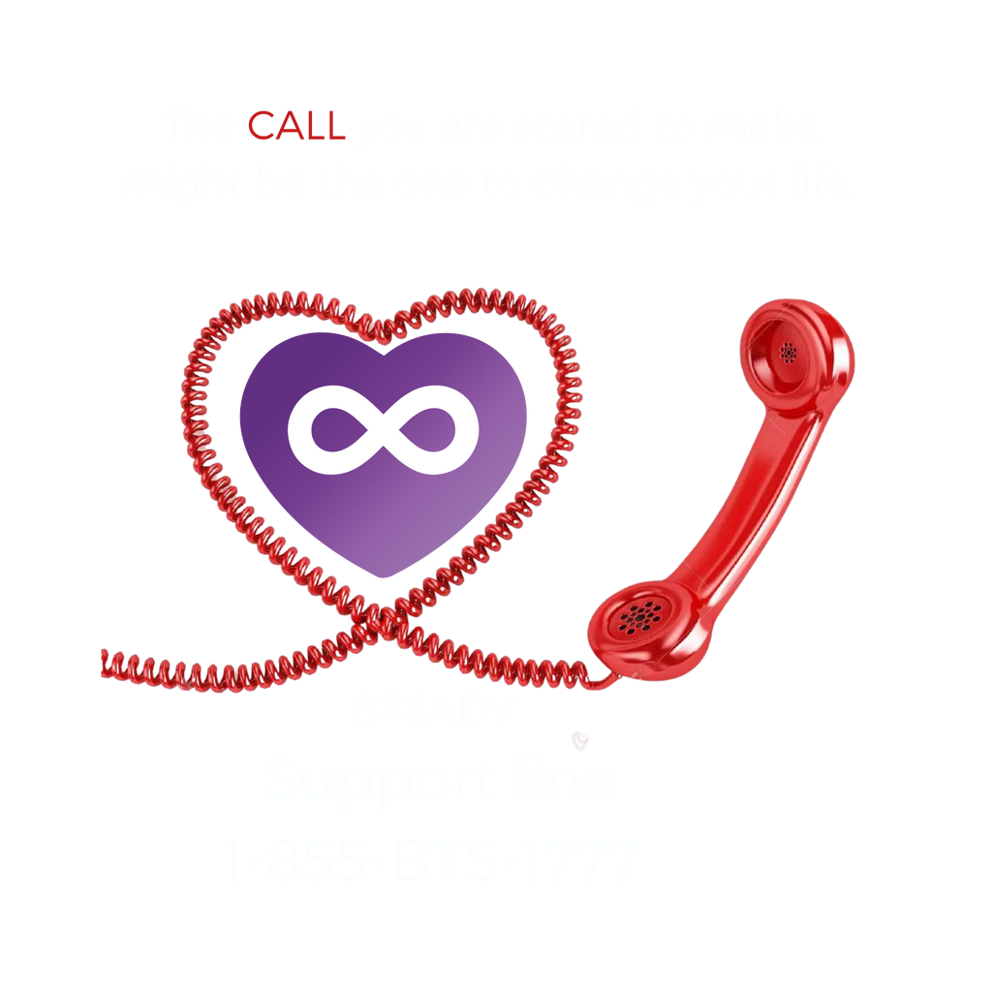
THANK YOU
FOR YOUR SUPPORT
BTSADV. ORG

