Slide 1
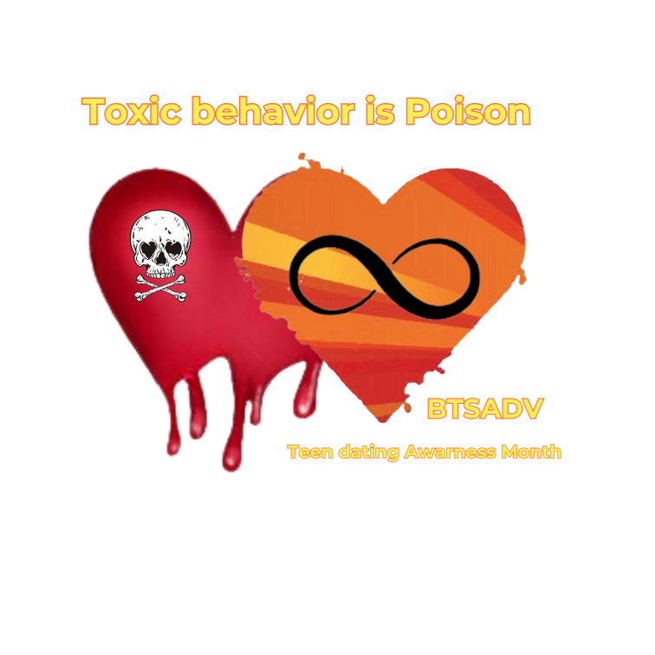

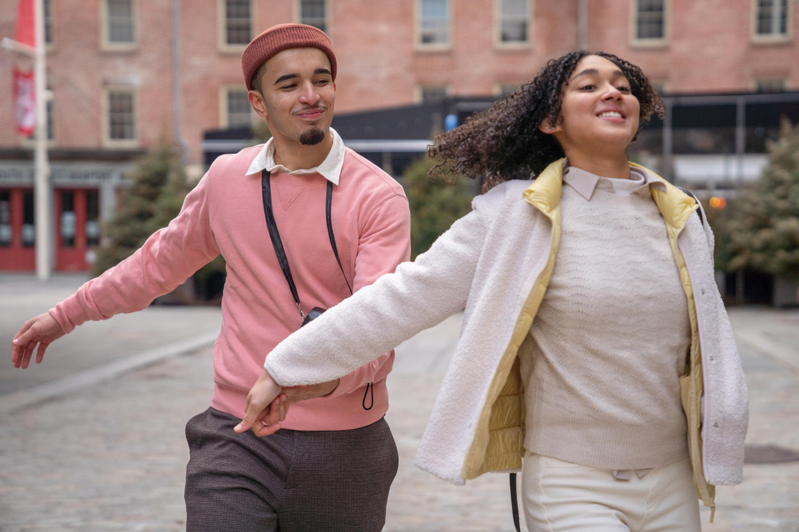

Who are we?
BTSADV started as a grassroots organization over 13 years ago.
Today, we’re a worldwide organization that has become the national voice against domestic violence.
BTSADV
(Break The Silence Against Domestic Violence)
https://breakthesilencedv.org/

Slide 2

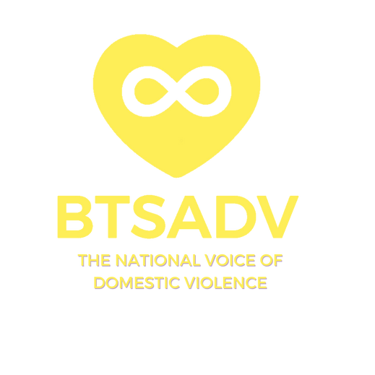
Teenage Relationships & Domestic Violence

Slide 3
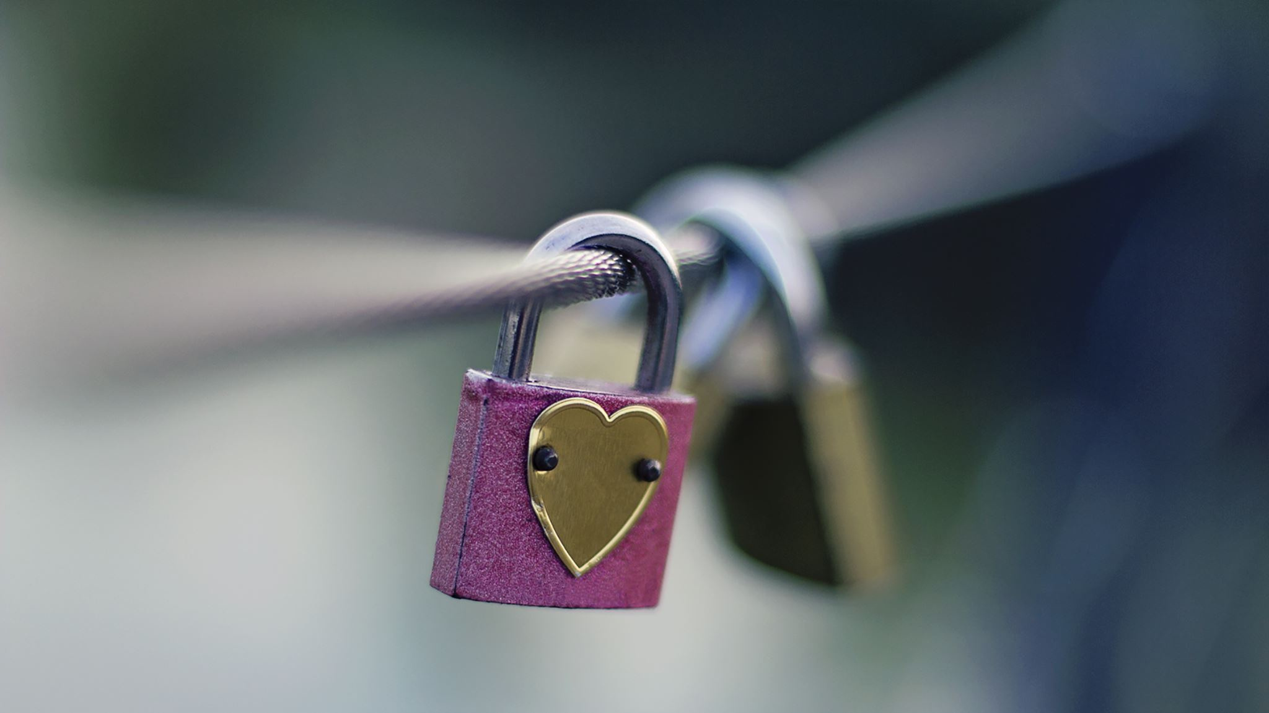
  Do you know what domestic violence is?
  How many of you have experienced some form of domestic violence in your relationship? Even if you are not sure, raise your hand.

Slide 4
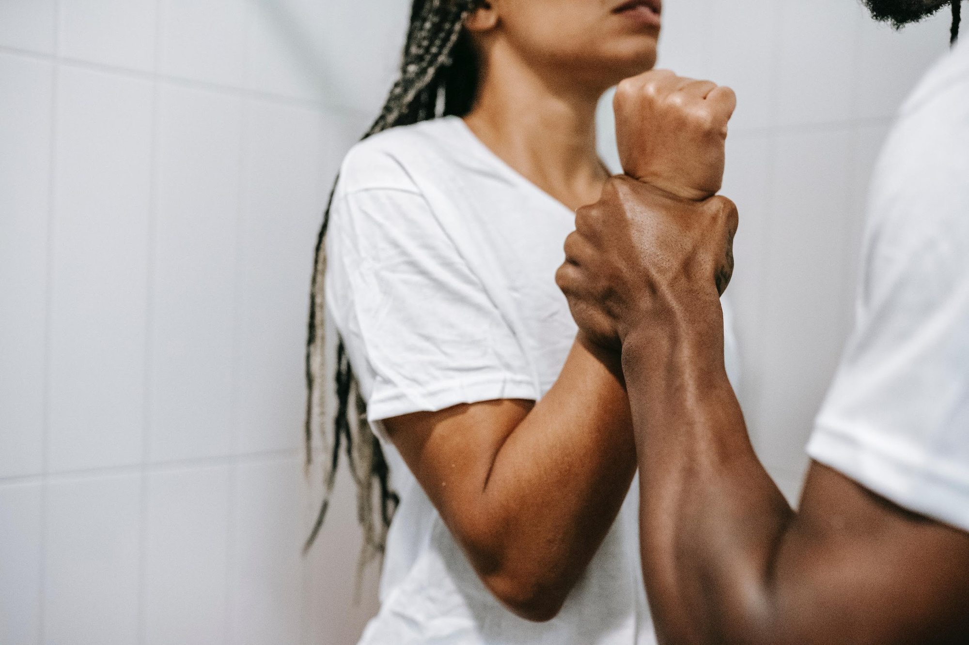
  The definition of domestic violence and how to help someone who may be experiencing it as per https://wscadv.org/about-domestic-violence/
  Abuse is a pattern of behavior that one person uses to gain power and control over the other. These behaviors can include:
  isolation from friends and family
  emotional abuse
  monitoring
  controlling the finances
  physical and sexual assault
  The fundamental harm of abuse is a loss of autonomy. Autonomy means independence and freedom from external control. Everyone should be free to make their own choices in relationships.

Slide 5
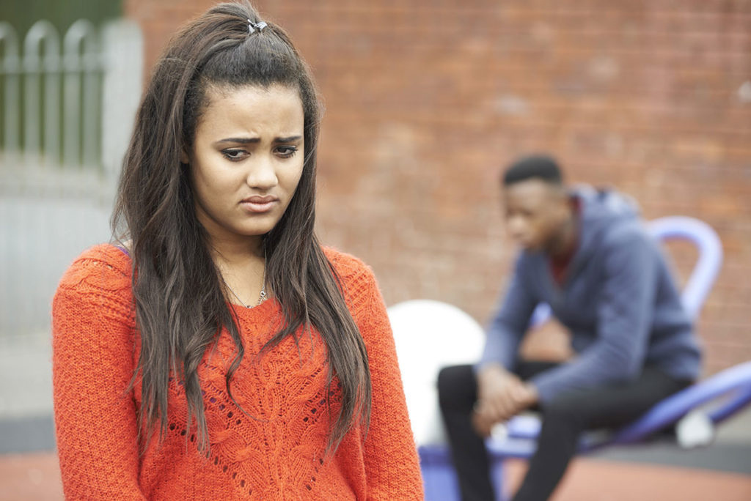
Teen Dating Violence Statistics
  Nearly 1.5 million high school students nationwide experience physical abuse from a dating partner in a single year.
  1 in 3 women/girls and 1 in 7 men/boys in the US is a victim of physical, emotional, or verbal abuse from a dating partner, a figure that far exceeds rates of other types of youth violence.
  1 in 10 high school students has been purposefully hit, slapped, or physically hurt by a boyfriend or girlfriend.
  Only 33% of teens who were in an abusive relationship ever told anyone about the abuse.
  81% of parents believe teen dating violence is not an issue or admit they don’t know it’s an issue.

Slide 6
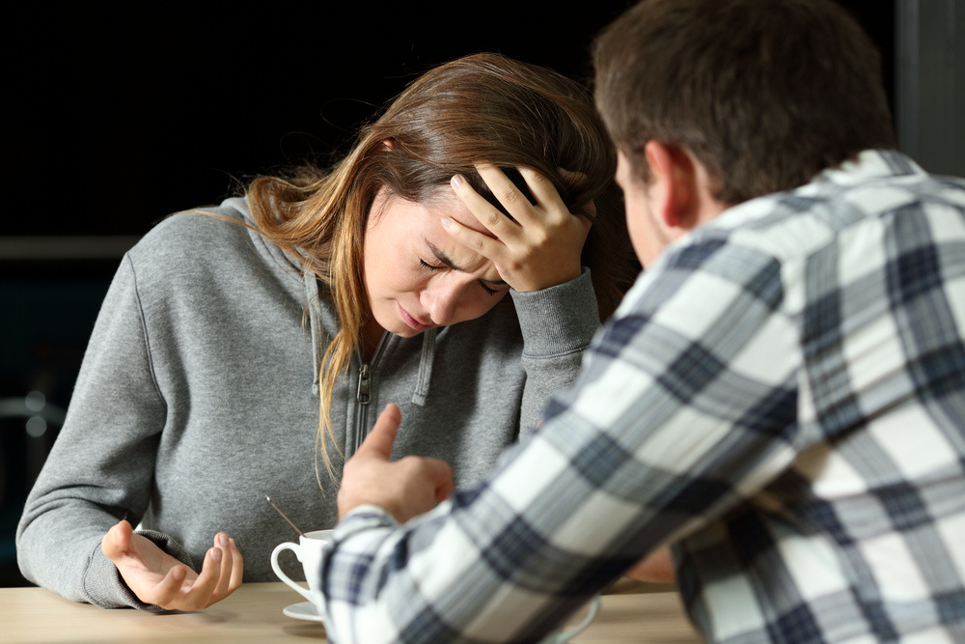
  Roughly 1.5 million U.S. high school boys & girls admit to being hit or physically harmed in the last year by someone they are romantically involved with.
  Teens who suffer dating abuse are subject to long-term consequences like alcoholism, eating disorders, promiscuity, thoughts of suicide, & violent behavior.
  1 in 3 young people will be in an abusive or unhealthy relationship.
  33% of adolescents in America are victim to sexual, physical, verbal, or emotional dating abuse.
  50% of young people who experience rape, physical or sexual abuse will attempt to commit suicide.
  ~dosomething.org~

Slide 7
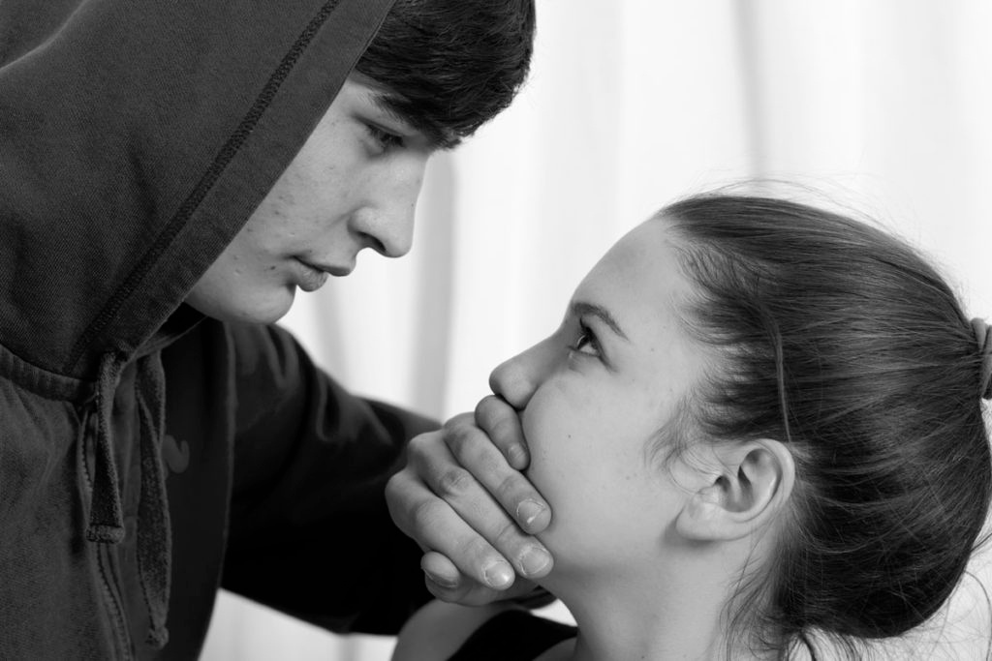
  In a study of eighth and ninth graders, 25% indicated that they had been victims of dating violence, including eight percent who disclosed being sexually abused. (American Journal of Preventive Medicine, 1996)
  Among female students between the ages of 15-20 who reported at least one violent act during a dating relationship, 24% reported experiencing extremely violent incidents such as rape or the use of weapons against them (Journal of Child & Adolescent Pediatric Nursing, 1994)
  In a survey of 232 high school girls, 17.8% indicated that they had been forced to engage in sexual activity against their will by a dating partner. (Child & Adolescent Social Work Journal, 1996)
  55% of female students and 75% of male students involved in acquaintance rape admit to having been drinking or using drugs when the incident occurred. (TeachingDegree, 2012)
  Over the course of an average 5-year college career, between 20 and 25% of women students are raped. Fewer than 5 in 100 rapes are reported. (US Department of Justice)
  ~ocadsv.org~

Slide 8
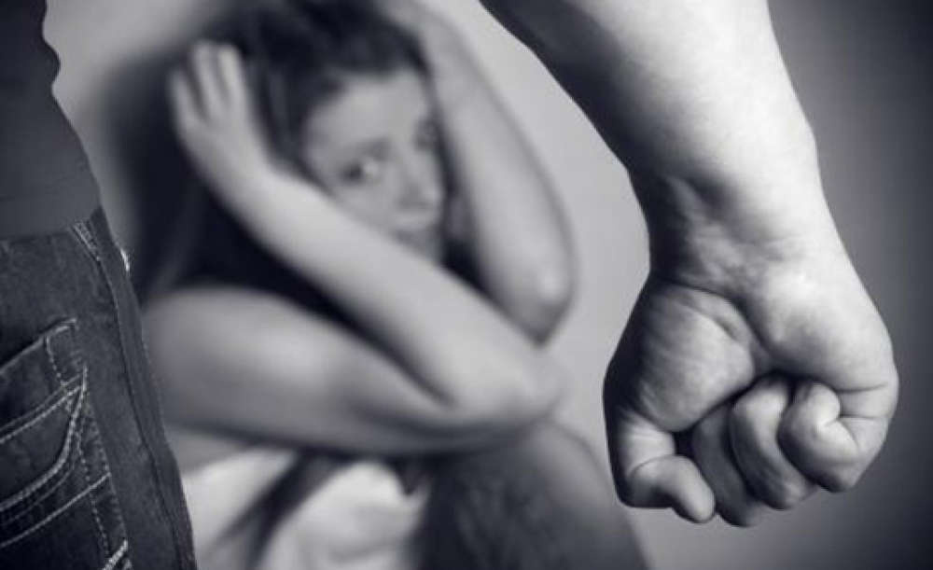
Teen dating violence is common.
  Data from CDC’s Youth Risk Behavior Survey and the National Intimate Partner and Sexual Violence Survey indicate that:
  Nearly 1 in 11 female and approximately 1 in 14 male high school students report having experienced physical dating violence in the last year.
  About 1 in 8 female and 1 in 26 male high school students report having experienced sexual dating violence in the last year.
  26% of women and 15% of men who were victims of contact sexual violence, physical violence, and/or stalking by an intimate partner in their lifetime first experienced these or other forms of violence by that partner before age 18.
  Some teens are at greater risk than others. Sexual minority groups are disproportionately affected by all forms of violence, and some racial/ethnic minority groups are disproportionately affected by many types of violence.
  ~www.cdc.gov~
  (https://www.dvs-or.org/teen-dating-violence-statistics/, n.d.)

Slide 9
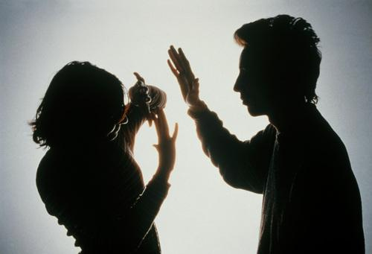
How do I know if it is abuse or just a bad relationship?
  In some ways, it doesn’t matter if it’s abuse or not—if someone is being hurt or controlled, they deserve better. But it is helpful to know if it is abusive for a couple of reasons:
  You might need some help from a local domestic violence program or hotline.
  You will need different strategies to address safety and privacy concerns.
  People who are abusive to their partners believe that:
  they have a right to control their partner,
  their bad behavior is justified, and
  their partner is to blame for the problems in the relationship.
  They also may manipulate others by:
  Confusing people by saying that they are the victim. This makes it harder for their partner to get support and be believed.
  Using systems to limit their partner’s options. For example, calling the police to get their partner arrested or getting Child Protective Services (CPS) involved to question and undermine their partner’s parenting. This entangles survivors in those systems and makes it hard to access that help in the future.

Slide 10
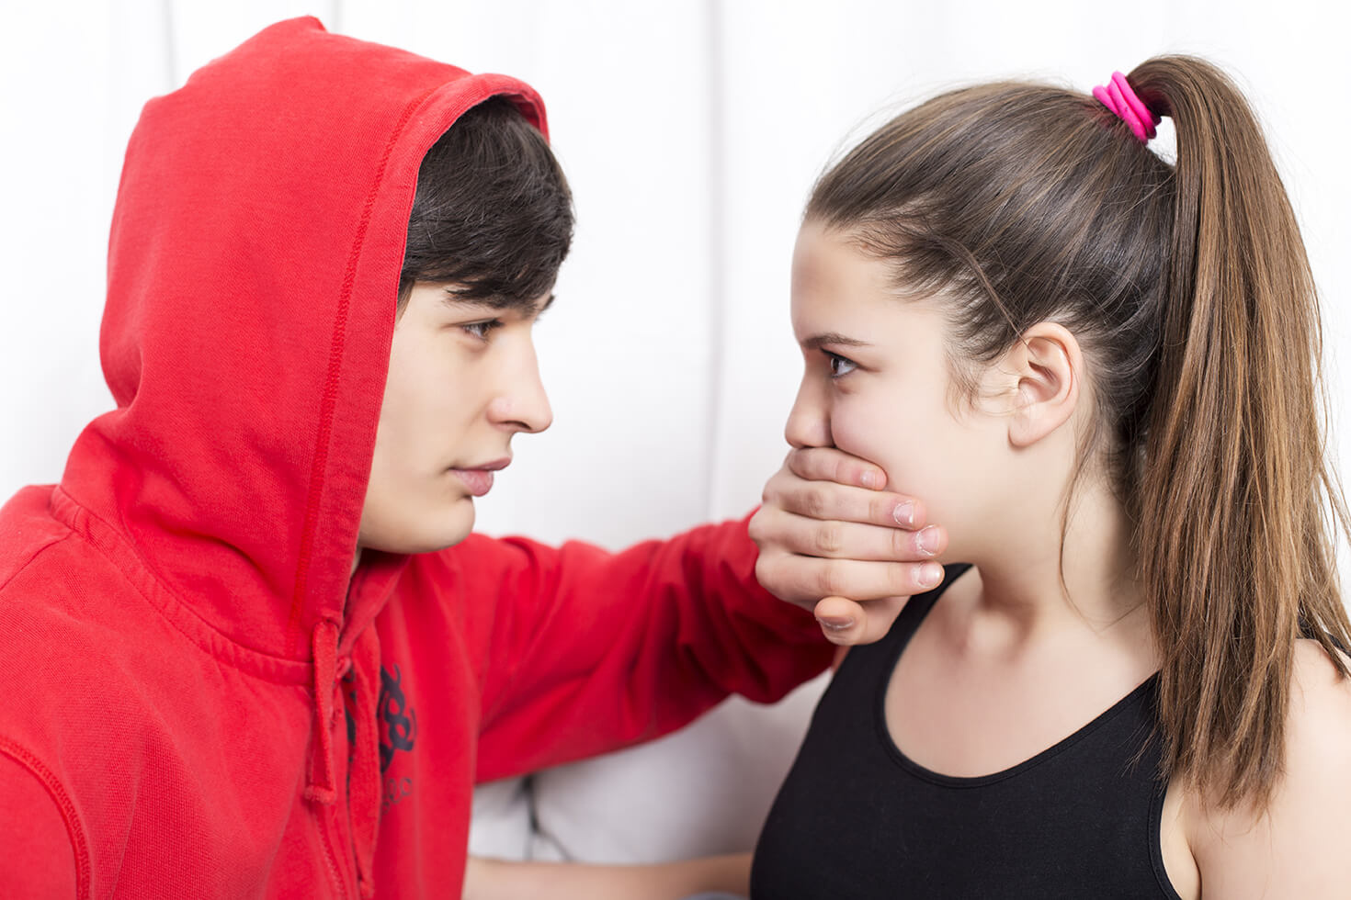
Now that you have a clearer definition of abuse, has anyone here experienced domestic violence or are still experiencing it? If you are too scared to raise your hand, please feel free to come talk to me or any other adult afterwards.

Slide 11

What can I do to support someone experiencing abuse?
  These three strategies show your willingness to show up and support someone. You don’t need to be an expert or have all the answers. Just being there and available is what people have told us helps most.
  Ask a question:
  Asking “How’s it going?” and really caring about the answer is powerful.
  Some other possible questions to ask:
  What is your biggest concern?
  What are you most worried about?
  What do you need or want?
  What do you need from your community?
  How can I help?
  What is life like with [partner’s name]?
  How are the kids doing?
  Is this relationship energizing or draining?
  Do you get to do the things you like to do?
  What happens if you disagree?
  What does arguing look like in your relationship?

Slide 12
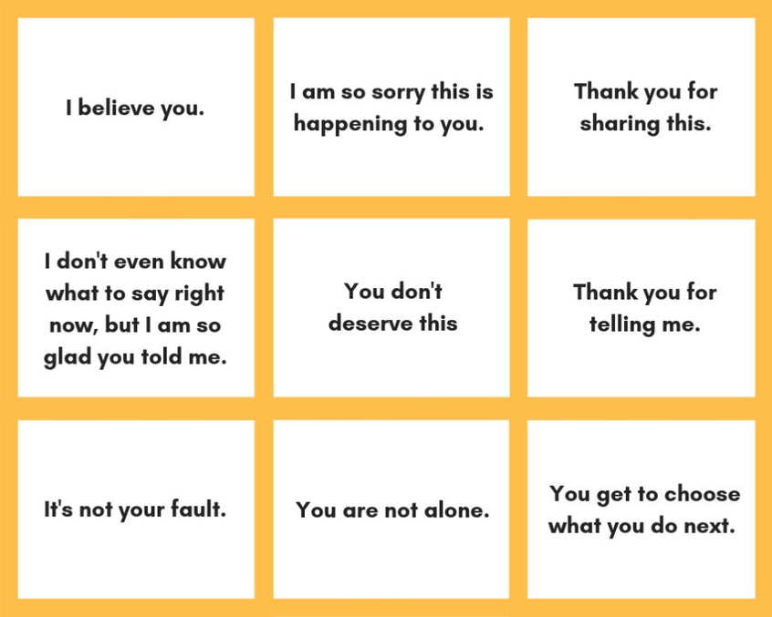
Listen Up
Really listen.
Listen without having your own agenda. Being heard helps. Acknowledgment makes all the difference.
Things you can say to people who have experienced harm:
When you’re listening deeply to someone, you are not trying to get to your point of view, you are trying to hear their perspective.

Slide 13



  You’re also listening for what the person thinks about risks, priorities, and concerns. Bottom line: you are listening to hear what the person is experiencing, what they want, and how you can help.
  Starting to feel worried? If you’re hearing something (they’re isolated, being monitored or stalked, the person has a weapon) that makes you concerned they are in immediate danger, you (or both of you together) can call the National Domestic Violence Hotline to produce a plan to stay as safe as possible.
  Some particularly risky stuff to listen for:
Btsadv Supportline 1-855-BTS-1777

Slide 14
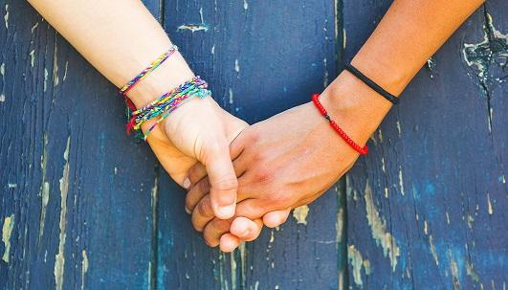
Stay connected
  It can take a long time for things to get better, and it can be difficult to hang in there through it all. But staying connected is one of the most helpful things you can do. When someone is isolated, the abuser has far more power and control over their lives. You do not need to know all the answers or agree with every decision to be helpful. Instead, consistently show up, take on what you can, and ask for help with things that are difficult for you.
  Connection also means no ultimatums. We’ve learned that tough love is not what folks need. You might be the only person they are reaching out to. If you give them an ultimatum that they can’t live up to, they won’t have anyone left. Instead, try to leave the door open to make it easy to keep coming back to you.
  Even if the person you’re concerned about doesn’t reach out, you can be the one to reach out. This takes some of the power away from the abuser and can be a lifeline for your loved one. It might be that they aren’t calling or reaching out because they can’t, not because they don’t want to or don’t need support.
  That said, we know that it’s hard to stay connected when you’re worried and scared, and nothing seems to be changing. It is not helpful to sacrifice your own well-being in the hopes of helping someone else.
  If you need help, talk to your trusted people and reach out to experts. If you need to take a break, take it.

Slide 15
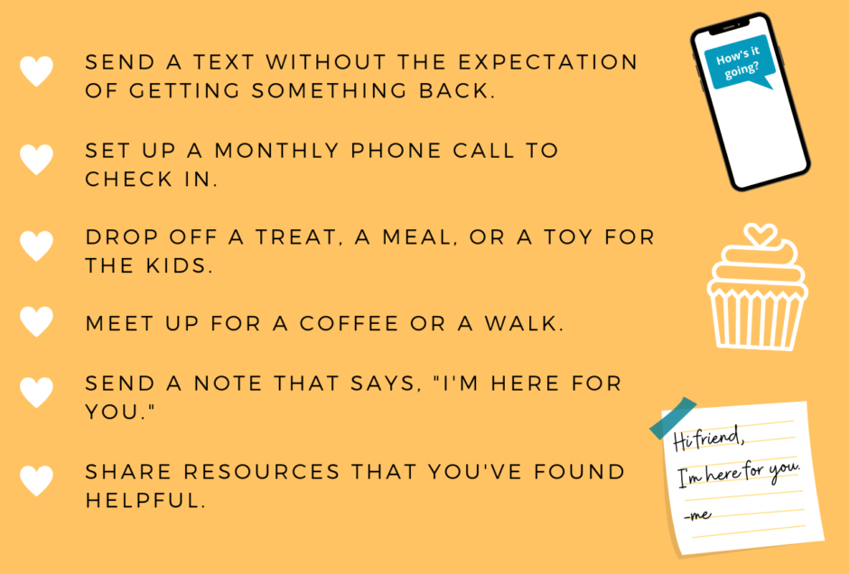
If someone is having a hard time in their relationship, you can be a lifeline. There are lots of ways to stay connected. You can:
It doesn’t need to be perfect to have an impact. Just trying is what matters most.

Slide 16
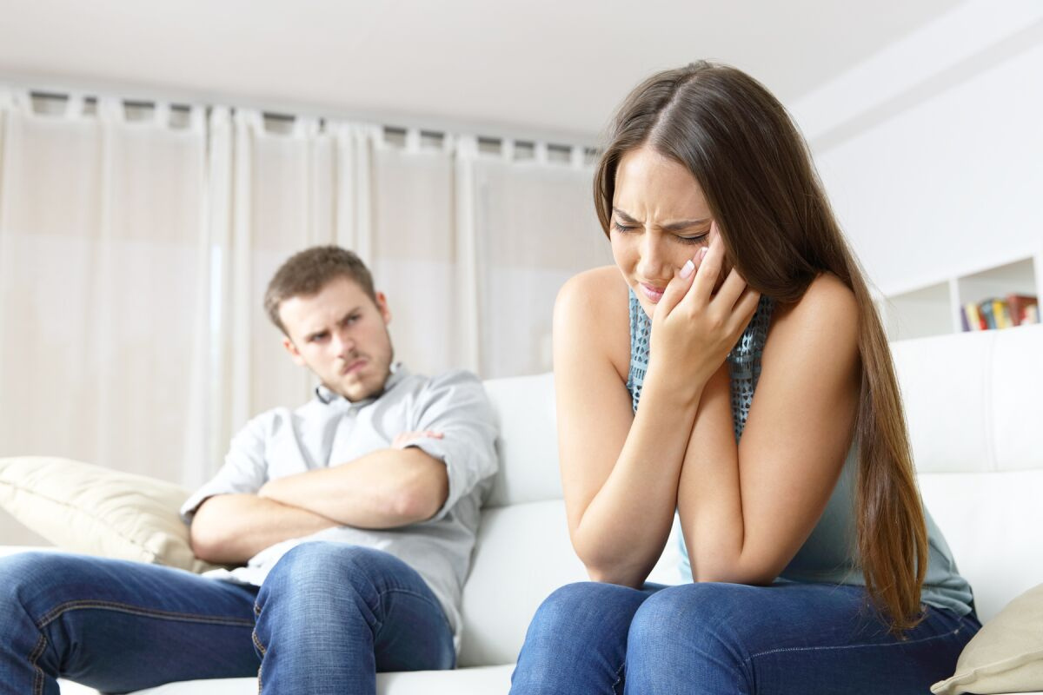
Feeling nervous about what might come up?
  Get through those awkward moments with these tips.
  Conversation going nowhere? When you’re getting silence or one-word answers, it’s best to back off and try again a different day. Just asking questions lets people know you are someone they can turn to when they are ready.
  Don’t know the answer? Try saying: “Honestly, I don’t know. Let me do some research and then we can talk more tomorrow.”
  Totally freaked out by what you just heard? Let them know you need a little time: “I’m glad you’re talking to me. I want to keep talking, but it would help me to have some time to think about all this. Can we check in again another time?”
  Not feeling great about your own relationship? You don’t need to have it all figured out to support someone else. Remember, you can always reach out to domestic violence advocates and think about who might be open to listening to you, even if they’ve never asked you about your relationship.

Slide 17
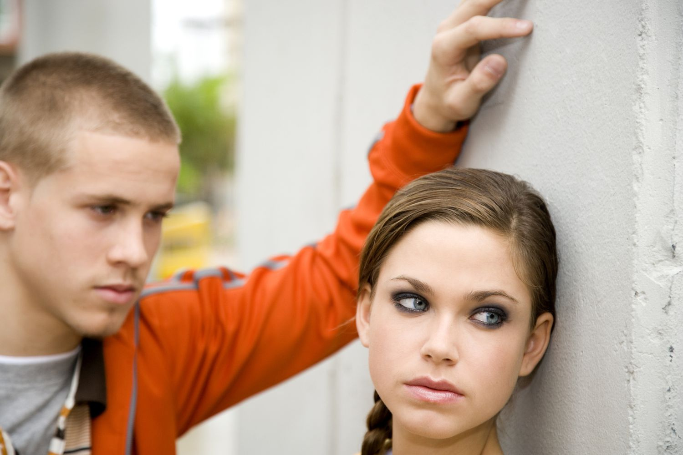
VALUES
  We believe in a better FUTURE
  Faith - Believing in the possibility of a world without domestic violence.
  Unity - Creating harmony among humanity
  Transformation - Changing the condition of our current culture
  Unique - Taking an innovative approach in all we do
  Resilient - Spring forward despite facing adversity
  Empowering - Embracing your abilities within

Slide 18
